Slide 1

CUSTOMER BOOKING INSIGHTS
BY: TITO OSADEBEY
05/06/2024

Slide 2
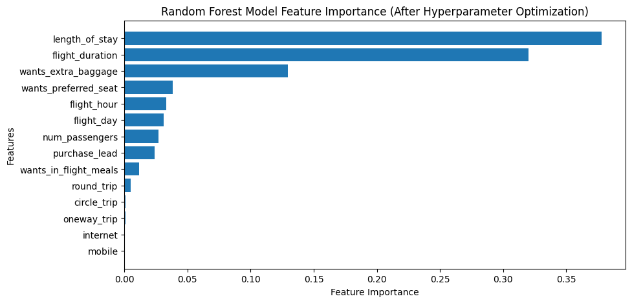
RESULTS AND FINDINGS
ROC AUC
61%
(Before Optimization)
ROC AUC
62%
(After Optimization)
Data is highly imbalanced with successful bookings just 14.95%. I suggest adding more data with successful bookings to make it partially balance.
Malaysia has the most complete bookings.
Most bookings were done through the Internet (88.76%).
Bookings with round_trip type was the highest (98.99%).

